Slide 1
Hit Tracks From 50’s Blues to 20’s Rap: Analyzing Features of Billboard’s Hottest Songs
Ashton Cho, Deric Liang, Wes Morberg

Slide 2
Introduction & Hypotheses
Billboard ranks songs based on sales/streams on weekly basis
Pull data on Billboard rankings from 1958-2021 and combine with song attributes pulled from Spotify API
Determine characteristics indicating popular songs
Hypotheses
Audio features influence songs’ rank and popularity scores
Genres have distinct audio feature characteristics and vary between genres (loudness, energy, danceability, etc.)
Chronological shifts exist in genres and features of popular tracks, from 1958-2021
Artists with the most Billboard hits will include Taylor Swift, Kanye West, The Beatles, Drake, The Weeknd, and Michael Jackson
Higher popularity for songs in major keys and songs 2:30-3:00 minutes in duration
Notes:
Deric

Slide 3
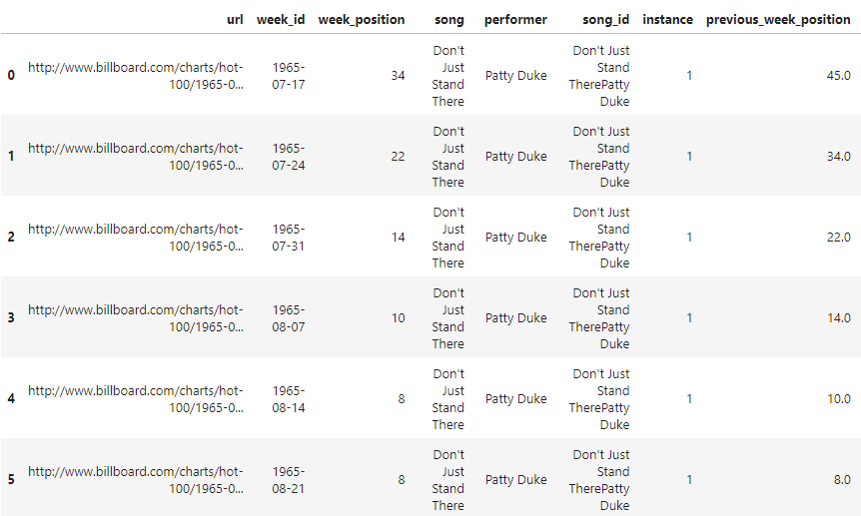
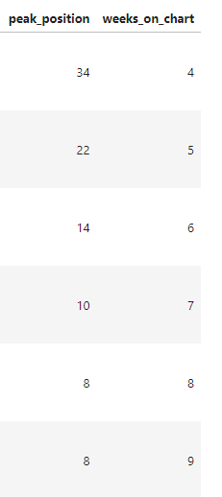
Sanity Check
billboard.csv
Shape: (327895, 10)
Notes:
Speaker: Ashton Cho
Check missing values.
Missing values for ‘previous_week_position’. The NaN values in the 'previous_week_position' column show songs that have entered the Hot 100 chart for the first time, thus having no ranking in the previous week.
Check unique values.
Any columns related to billboard ranking/ position had 100 unique values.
About 24,000 unique song names, 10,000 artist names, and 29,000 song_ids (a concatenation of song and artist).
This indicated that about 5000 different songs shared the same song title.

Slide 4
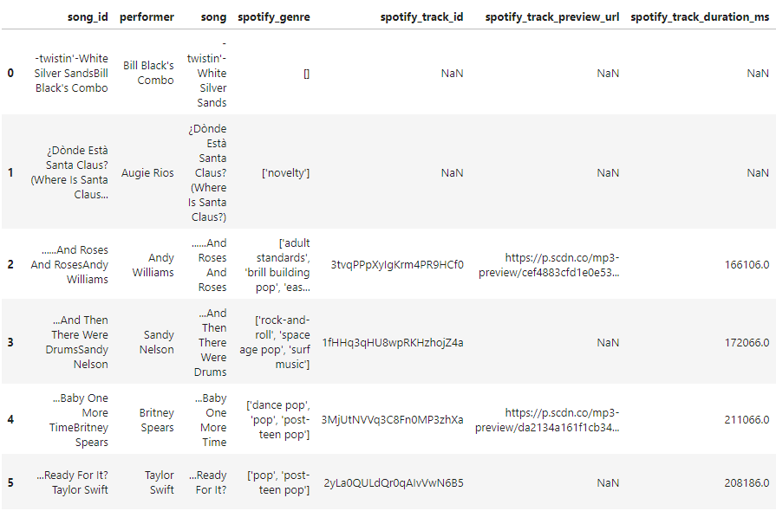
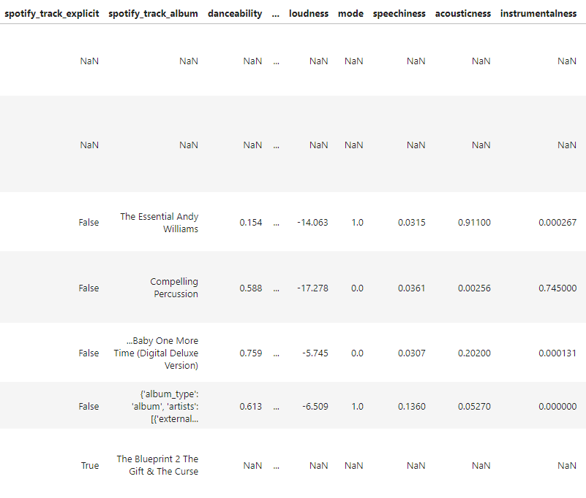
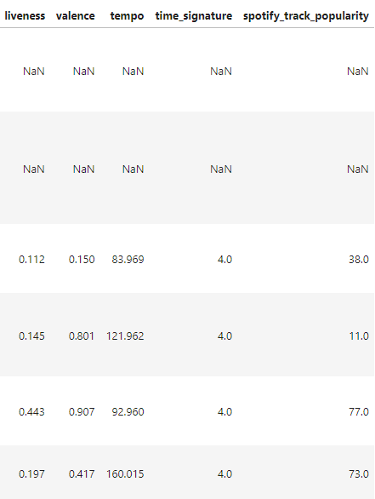
Sanity Check
audio_features.csv
Shape: (29503, 22)
Notes:
Speaker: Ashton Cho
Check missing values.
Audio features dataframe had about 5,000 NaN values for the audio_features. These rows were kept to be merged with the billboard dataframe.
The Spotify API documentation describes the audio features.
Danceability: how suitable a track is for dancing.
Energy: a measure of intensity.
Speechiness: the presence of words.
Acousticness: a confidence measure of whether the track is acoustic.
Instrumentalness: whether a track contains no vocals.
Liveness: detects the presence of an audience in the recording.
Valence: the musical positiveness conveyed by a track

Slide 5
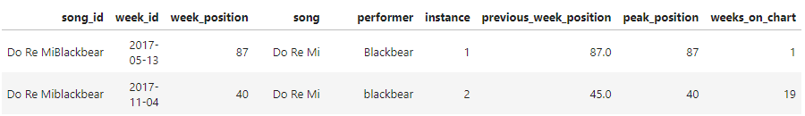
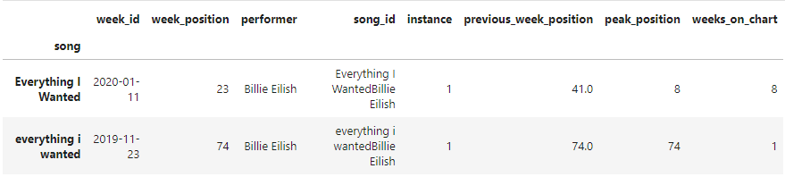
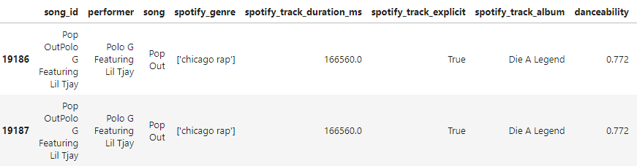
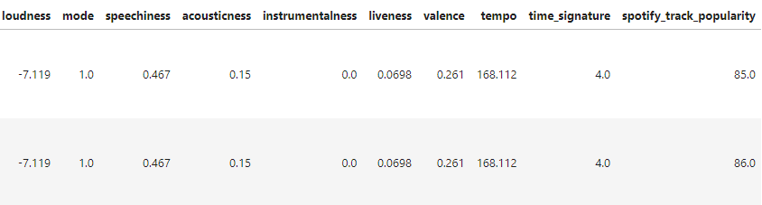
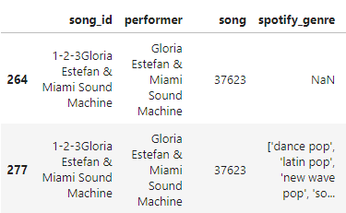
Data Cleaning and Merging
Notes:
Speaker: Ashton Cho
Fix song and artist name case issues.
Drop Duplicates. Some rows had all the same values except popularity score. The row with the higher score was kept.
Duplicates with an empty ‘genre’ column were also dropped.
Drop unnecessary columns, such as url.
Merge on song_id.

Slide 6
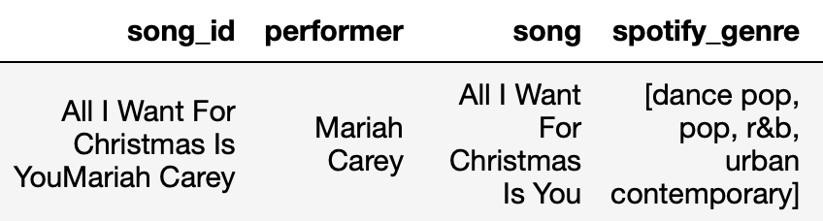
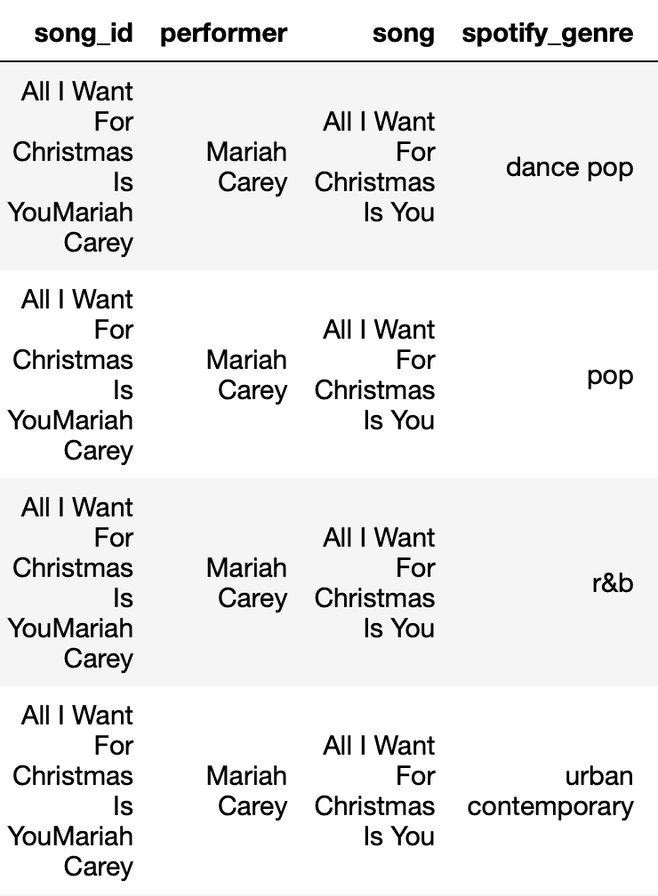
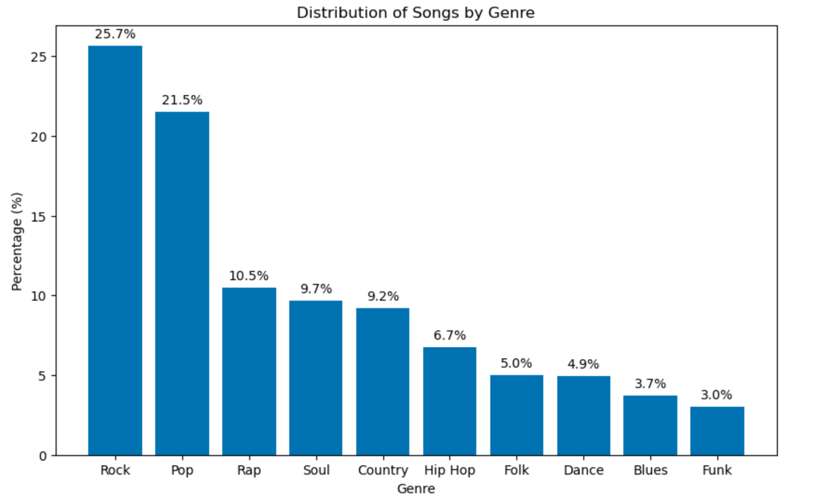
Genre Data Preprocessing
df.explode( )
Label subgenres into 1 of 10 genres and drop outliers
Notes:
Wes
Additional preprocessing required to analyze by individual genre
Genre data from api stored as a list and required explode() function from pandas module to break out by genre
Individual subgenres

Slide 7
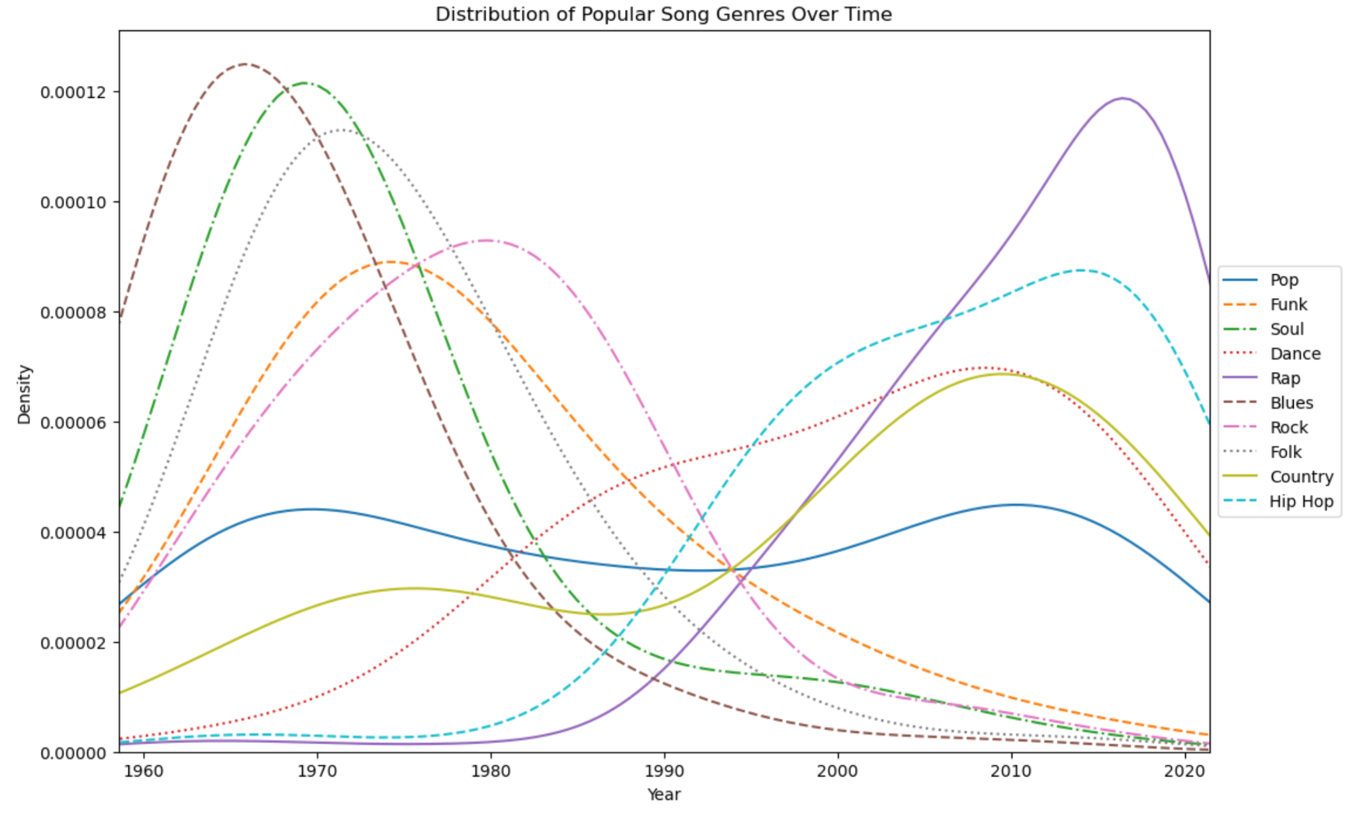
Kernel Density Estimate (KDE) Plot of Genre Popularity Over Time
Notes:
Wes
Here, we used a seaborn Kernel Density Estimate (KDE) plot native to seaborn
Functions like a “smoothed” histogram and a cleaner result when analyzing 10 distributions

Slide 8
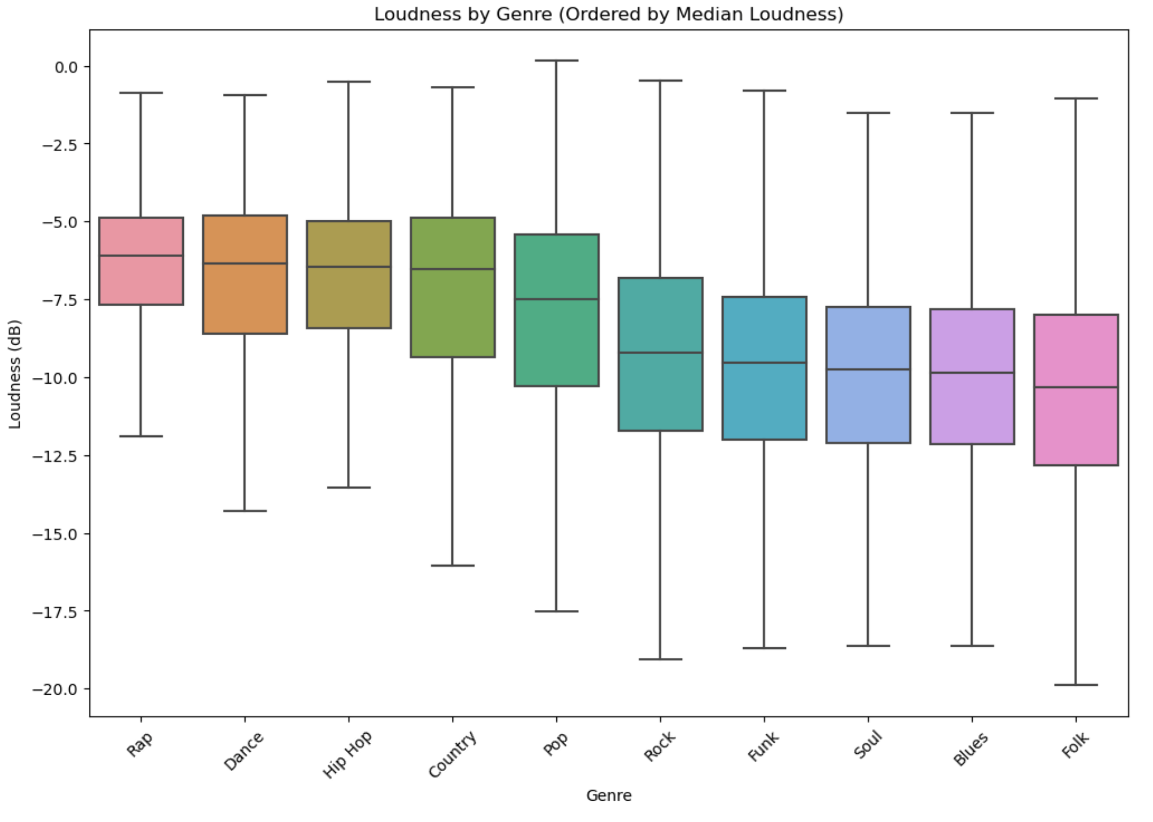
Box and Whisker Plot of Song Loudness by Genre
Notes:
Wes
We then generated a box and whisker plot native to seaborn building off the prior visual
Our goal here was to assess whether the more modern popular genres tended to be louder according to their decibel value
This plot displays the box or inner 50th percentile (25th-75th) with middle line displaying median or 50th percentile
Outer whiskers represent 1.5 times the Interquartile range
This visual confirms that modern genres like rap, dance, and hip hop are much louder than older genres

Slide 9
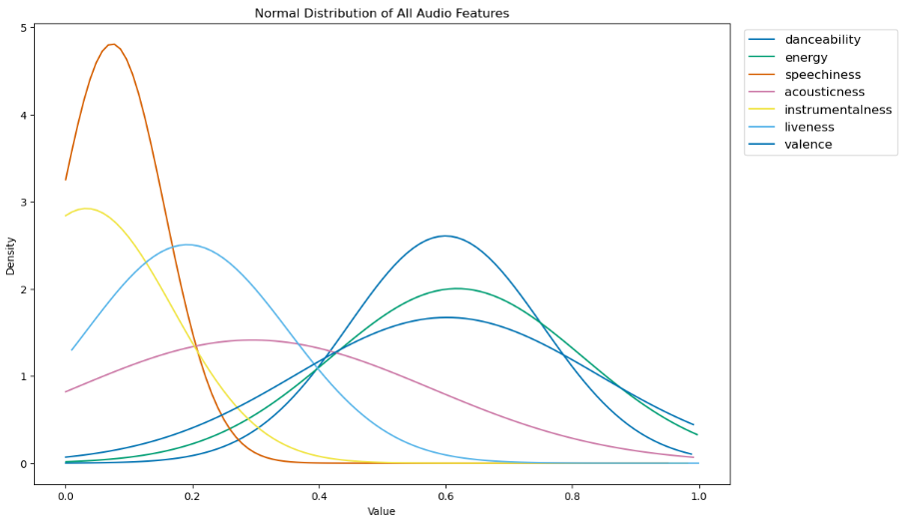
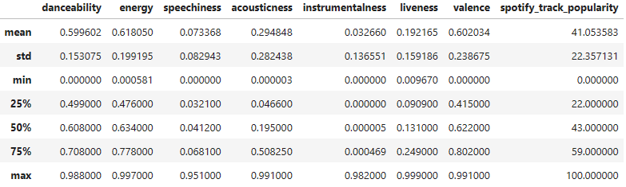
Normal Distribution of Audio Features
Notes:
Speaker:
Using the scipy module, bell curves of all the attributes were plotted.
As seen in the table above, the range of the audio feature values span from 0 to 1.
The “mean” values correspond to the peak of the bell curves, and the ‘std’, or standard deviation, values determine the steepness of the curves.
The graph details the audio feature values of all the tracks in the data set.

Slide 10
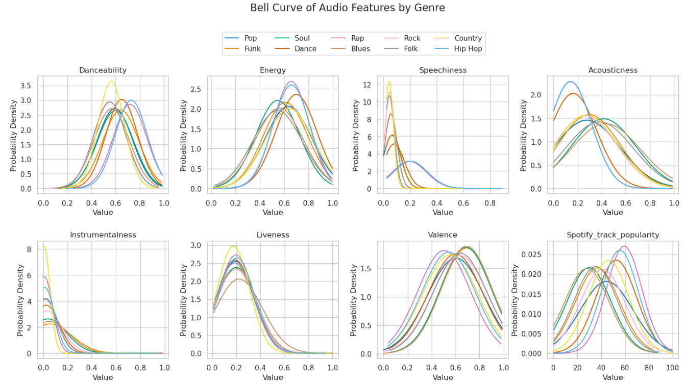
Analysis of Audio Features by Genre
Notes:
Wes
This visual displays a facet grid of normal distributions for each genre by characteristic
Each of these features are scored from 0-1 based on the Spotify algorithm
Some features appear to have little differences across genres, including danceability, instrumentalness, liveness and valence
However, some key differences like Energy, where we see distinct peaks for hip hop, rap, and dance suggesting this is a characteristic of the genre
Also interesting to note is the clearly higher peak values for hip hop, dance, and rap for the spotify popularity algorithm, as these genres likely more
Popular with spotify users

Slide 11
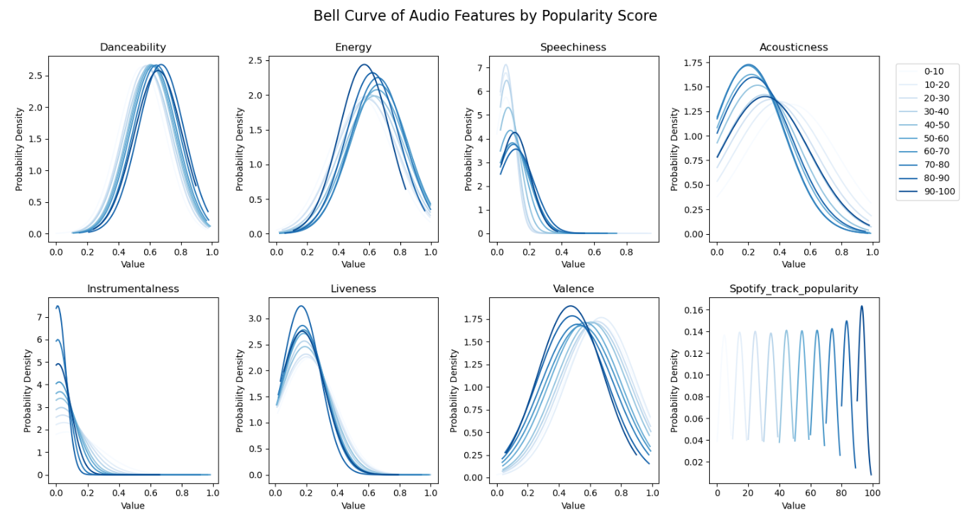
Notes:
Speaker: Ashton Cho
Track popularity, ranging from 0 to 100, is primarily determined by the total number of recent plays.
Higher popularity scores indicate songs that are currently receiving more plays, emphasizing the influence of recent listening trends over historical play counts.
Several details can be seen in the plots above. Tracks with higher popularity scores are seen to have slightly higher danceability and speechiness values and slightly lower instrumentalness, liveness, and valence values.
This is consistent with rap (with its high likelihood of containing spoken words) as well as hip hop and dance (genres associated with danceability and energy) being the most popular genres.

Slide 12
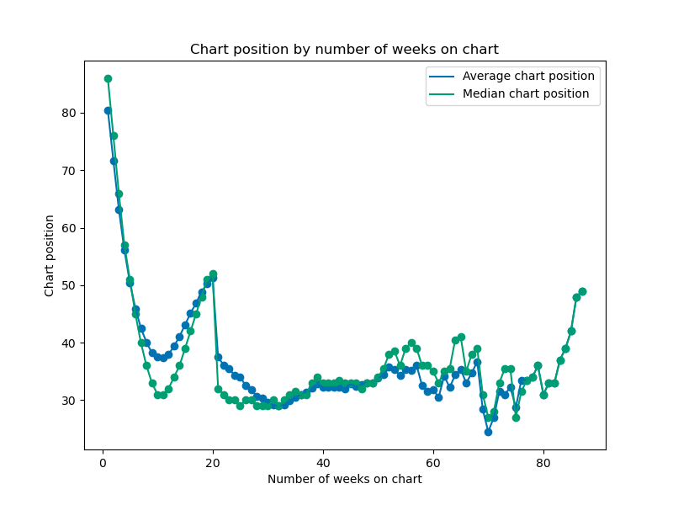
Song popularity over charting life
Notes:
Deric
Popularity measured by both number of weeks on chart and position on chart
Songs gradually become more popular in its first 10 charting weeks
Decline in popularity after week 10
Songs with longevity (> 20 weeks) naturally show better average chart position

Slide 13
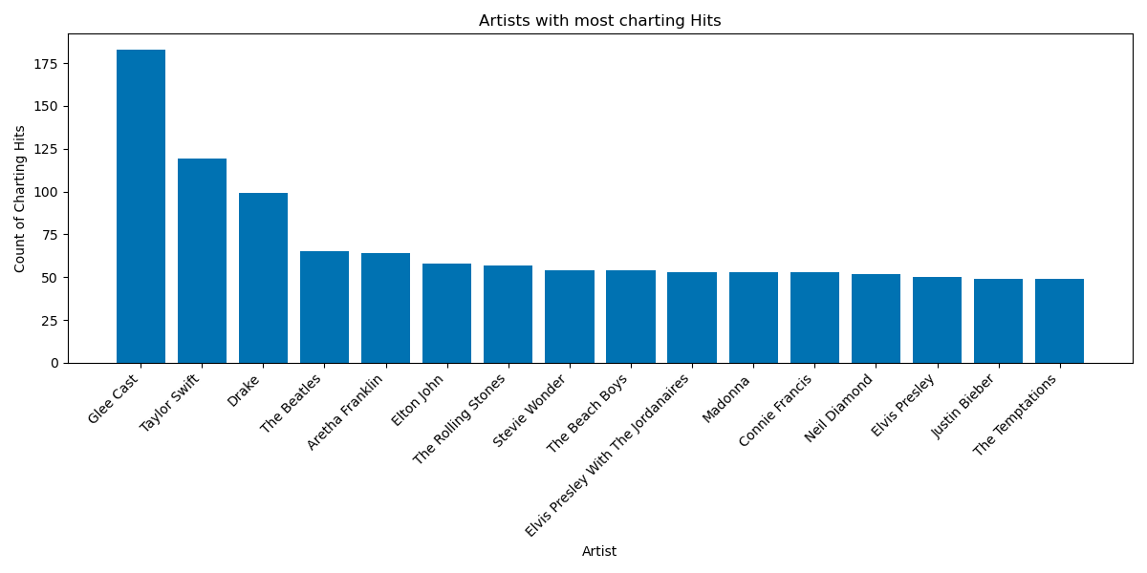
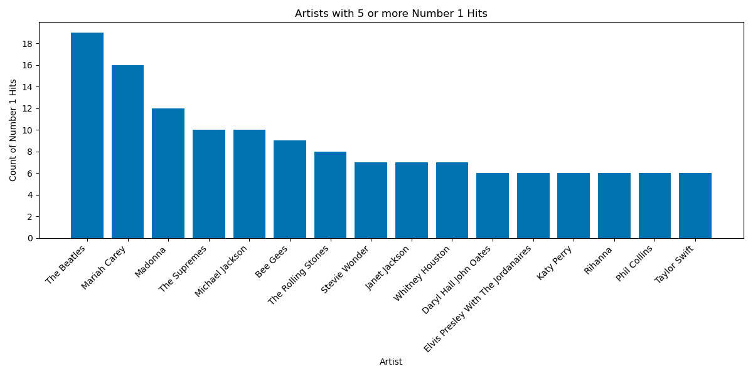
Recurring artists on charts
Notes:
Deric
Glee Cast surprisingly charts the most - could be that they are advantaged in being able to reproduce popular songs from multiple artists
Taylor Swift, Drake charts less than we thought, especially on Number 1 chart
Beatles only artist to consistently chart a lot and record Number 1 hits
Contrast to Taylor Swift with second most charting hits but lower end of Number 1 among top artists

Slide 14
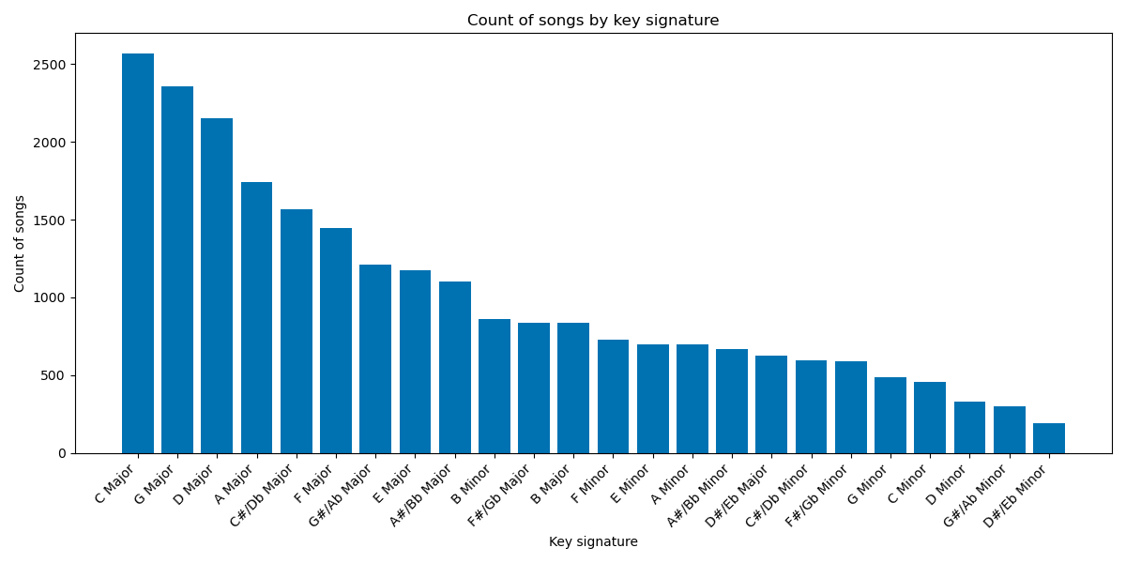
Other attributes: key signature
Notes:
Deric
Major keys more popular, audiences like happier music
Minor keys less popular, audiences don’t like sadder music
From a musician perspective, simpler keys for learning and playing often opted for and effective for popularity

Slide 15
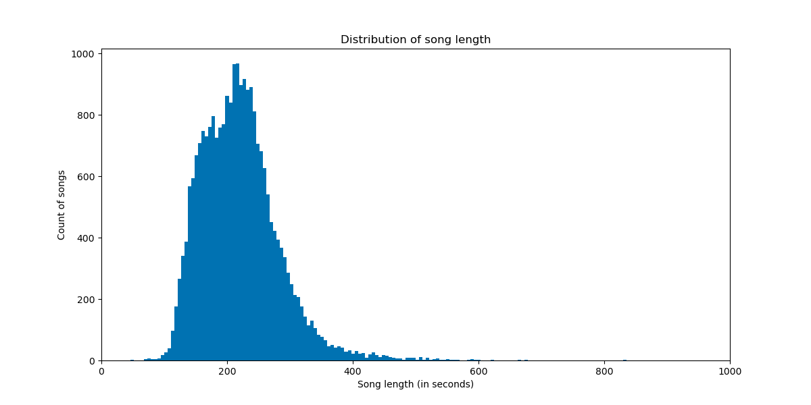
Other attributes: song duration
Notes:
Deric
Popular songs typically around 3-3.5 minutes
Thought that audiences would like shorter songs, around 2.5-3 minutes in length
Heavy right skew, meaning longer songs can become popular but is more rare

Slide 16
Conclusion
Hypotheses
Audio features influence songs’ rank and popularity scores
Genres have distinct audio feature characteristics and vary between genres (loudness, energy, danceability, etc.)
Chronological shifts exist in genres and features of popular tracks, from 1958-2021
Artists with the most Billboard hits will include Taylor Swift, Kanye West, The Beatles, Drake, The Weeknd, and Michael Jackson
Higher popularity for songs in major keys and songs 2:30-3:00 minutes in duration
Further possible steps
Notes:
Deric
Returning to our hypotheses, generally we found surprising results with the first and fourth hypotheses, and results in line with what we expected for the remaining hypotheses.
Further possible steps: More recent 2021, pursue a more granular analysis of how attributes vary between genres, or create statistical models to measure correlations between song popularity metrics and song attributes, controlling for genre.

